Slide 1
What are spring beans?
Spring beans are the objects which are created and managed completely by spring container.
Beans can be defined in spring either by using XML configuration or by using Annotation.
In XML configuration, bean can be defined using < bean > tag inside < beans > tag.
In Annotation configuration , bean can be defined using the annotations like @Component,@Service,@Controller,@Repository on top of the class definition.
We can also achieve beans definition completely in java class by using java configuration.
Key advantage of making any class as spring bean is that, its entire life cycle is managed by Spring container and it helps us to achieve decoupling.
Spring bean
Spring bean
Spring bean
Spring bean
Spring bean
Spring Container

Slide 2
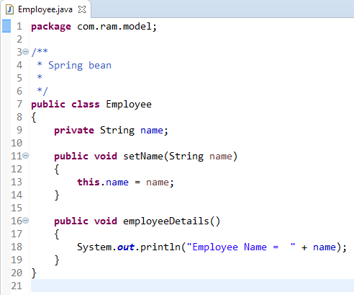
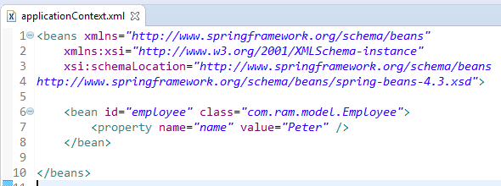
What are spring beans?
Each bean defined in the spring will have a unique identifier. Each bean is getting identified by its id.
Now employee object (also called employee bean) is will be created by spring container, and managed by spring container. Application can use this bean without worrying about creating this object, application also does not need to worry about destroying this object/bean after the use.
Each bean is getting identified by its id.
We are providing the information into the bean by applicationContext.xml file.

Slide 3
What are spring beans?
Employee
What object to instantiate?
What object to configure and how to configure?
The Spring Container
(ApplicationContext/BeanFactory)
applicationContext.xml
Employee
Object
name=“Peter”
Create the employee object.
Configure the employee object.
Manage employee object complete life cycle from creation till destruction.

Slide 4
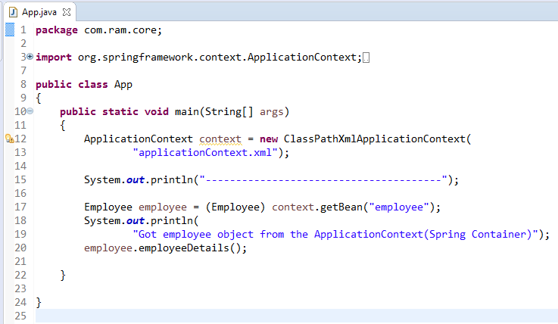
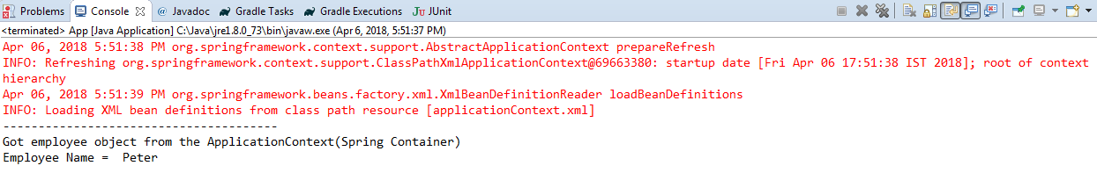
What are spring beans?
We can use the bean in our application either by injecting it to another bean or by loading this bean using spring container.
Here we have loaded the employee bean using its id and we can use it without worrying about its creation.

